Slide 1
Fluids
Physics
Unit 5
Notes:
Physics Unit 5

Slide 2
This Slideshow was developed to accompany the textbook
  OpenStax Physics
    Available for free at https://openstaxcollege.org/textbooks/college-physics
  By OpenStax College and Rice University
  2013 edition
Some examples and diagrams are taken from the textbook.
Slides created by
Richard Wright, Andrews Academy
rwright@andrews.edu

Slide 3
05-01 Fluids and Density
In this lesson you will…
• State the common phases of matter.
• Explain the physical characteristics of solids, liquids, and gases.
• Describe the arrangement of atoms in solids, liquids, and gases.
• Define density.
• Calculate the mass of a reservoir from its density.
• Compare and contrast the densities of various substances.

Slide 4
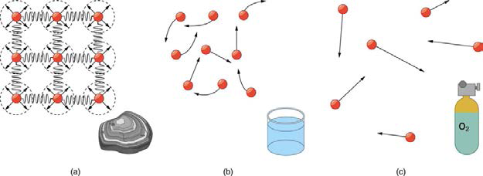
05-01 Fluids and Density
Phases of Matter
Solid
  Atoms in close contact so they can’t move much
  Set volume and shape
  Can’t compress
Liquid
  Atoms move past each other
  Set volume
  Takes shape of container
  Hard to compress

Slide 5
05-01 Fluids and Density
Gas
  Atoms far apart
  Neither set volume or shape
  Compressible
Fluids
  Flow
  Both liquids and gases

Slide 6

05-01 Fluids and Density
Density
  $ρ=\frac{m}{V}$
  Where
    $ρ$ = density
    m = mass
    V = Volume
Things with small density float on things with more density
Solids most dense
Gases least dense
  See Table 11.1

Slide 7
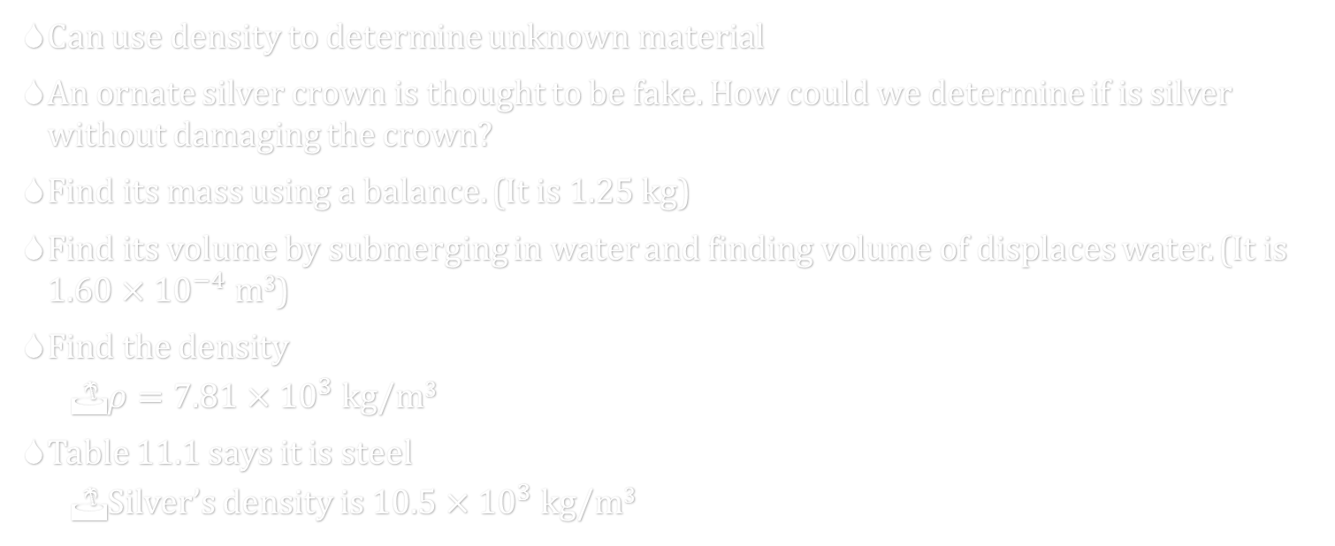
05-01 Fluids and Density
Can use density to determine unknown material
An ornate silver crown is thought to be fake. How could we determine if is silver without damaging the crown?
Find its mass using a balance. (It is 1.25 kg)
Find its volume by submerging in water and finding volume of displaces water. (It is $1.60×{10}^{−4}$ m³)
Find the density
  $ρ=7.81×{10}^{3}$ kg/m³
Table 11.1 says it is steel
  Silver’s density is $10.5×{10}^{3}$ kg/m³
Notes:
$$ρ=\frac{m}{V}$$
$$ρ=\frac{1.25 kg}{1.60×10^{−4} m^{3}}=7.81×10^{3} kg/m^{3}$$

Slide 8
05-01 Fluids and Density
Do the Density Lab
Objective
  Find the density in a coin and use it to help identify the metal.
  Use a Vernier caliper.
Materials
  Coins of standard metals
    Japan 1 Yen (1955-1989)
    Denmark 2 øre (1948-1972)
    Italy 50 Lire (1955-1989)
    France 1 Franc (1959-2001)
  Vernier caliper

Slide 9
05-01 Homework
Don’t be dense, you can solve these problems
Read 11.3, 11.4

Slide 10
05-02 Pressure and Depth
In this lesson you will…
• Define pressure.
• Explain the relationship between pressure and force.
• Calculate force given pressure and area.
• Define pressure in terms of weight.
• Explain the variation of pressure with depth in a fluid.
• Calculate density given pressure and altitude.

Slide 11
05-02 Pressure and Depth
The molecules in a fluid are free to wander around
In their wanderings they sometimes collide with the sides of their container (i.e. balloon)
The more the molecules collide with the walls, the more force is felt

Slide 12

05-02 Pressure and Depth
$$P=\frac{F}{A}$$
  P = Pressure
  F = Force perpendicular to surface
  A = Area of surface
Unit: N/m² = Pa (pascal)
  1 Pa is very small so we usually use kPa or atm

Slide 13
05-02 Pressure and Depth
In a fluid the pressure is exerted perpendicularly to all surfaces
A static fluid cannot produce a force parallel to a surface since it is not moving parallel to surface
Notes:
A parallel force would cause the fluid to flow because of Newton’s 3rd law

Slide 14
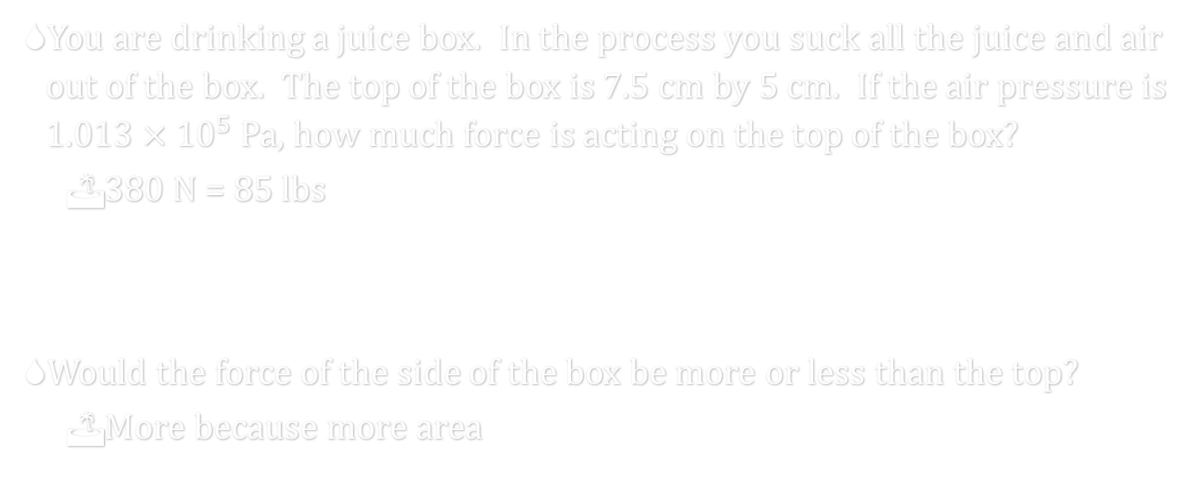
05-02 Pressure and Depth
You are drinking a juice box. In the process you suck all the juice and air out of the box. The top of the box is 7.5 cm by 5 cm. If the air pressure is $1.013×{10}^{5}$ Pa, how much force is acting on the top of the box?
  380 N = 85 lbs
Would the force of the side of the box be more or less than the top?
  More because more area
Notes:
$$A=0.075 m×0.05 m=0.00375 m^{2}$$
$$P=\frac{F}{A}→1.013×{10}^{5} Pa=\frac{F}{0.00375 m^{2}}→F=\left(1.013×{10}^{5} Pa\right)\left(0.00375 m^{2}\right)=379.875 N$$

Slide 15

05-02 Pressure and Depth
The force that squashes the juice box is from the weight of all the air above it
Atmospheric Pressure at Sea Level
  $1.013×{10}^{5}$ Pa = 1 atmosphere (1 atm)

Slide 16
05-02 Pressure and Depth
Do the Pressure vs. Depth Lab
When will the water flow out the farthest: when the water is nearly full, half-full, or nearly empty?
Hold the bottle over the bucket so that the water will flow out the hole into the bucket and loosen the bottle cap. Observe the flow of water. Put the cap back on!
Describe how the distance the water flowed out changed as the depth of the water changed.
The pressure of a fluid _________________________ as depth increases. So pressure and depth are ____________________________ proportional. This can be written as ____________________
Next Page
Notes:
Increases; directly; P = kh

Slide 17
05-02 Pressure and Depth
Consider taking an elevator down from the top floor of a tall building. Consider diving down under water. Which one makes your ears hurt more?
The pressure of a fluid __________________________ as density increases. So pressure and density are ___________________________ proportional. This can be written as __________________
Pressure is also directly proportional to the acceleration due to gravity, so P = kg. Put set 5, 9, and 10 together to write an equation relating pressure, depth, density, and gravity. Put all the variables that were directly related to pressure on the top of a fraction and all the variables that were inversely proportional on the bottom. (Let k = 1)
Why does the water not flow out of the bottle with the cap on tightly?
Notes:
Increases; directly; $P = kρ$
$$P=ρgh$$
There is no pressure in the bottle to push the water out.

Slide 18
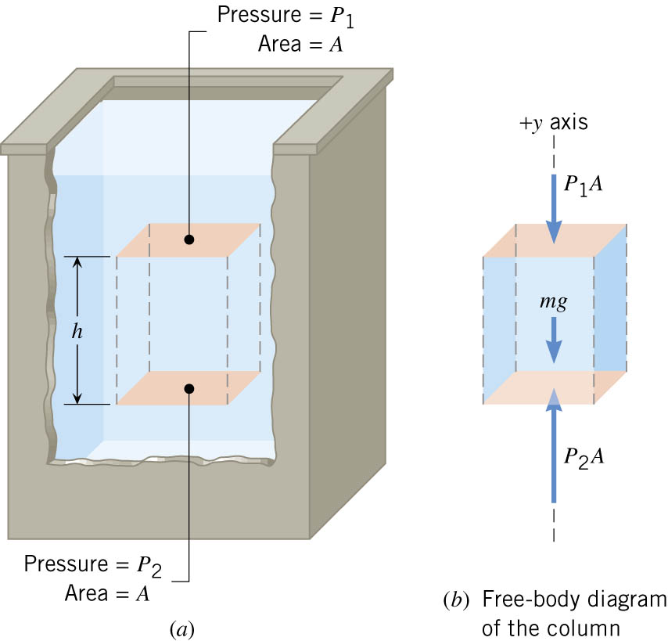
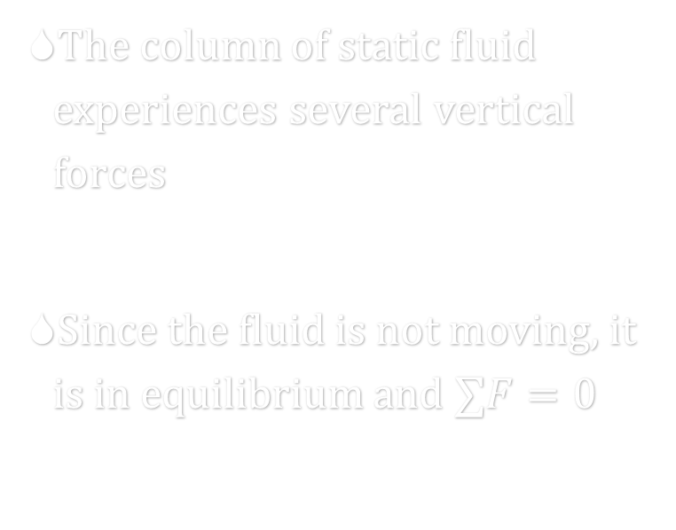
05-02 Pressure and Depth
The column of static fluid experiences several vertical forces
Since the fluid is not moving, it is in equilibrium and $∑F=0$
Notes:
There are horizontal forces also, but they will cancel each other.

Slide 19

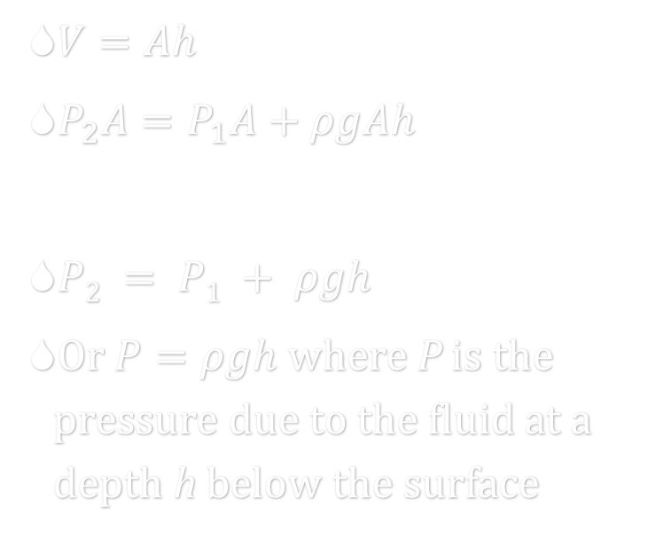
05-02 Pressure and Depth
$∑F=P_{2}A−P_{1}A−mg=0$
$P_{2}A=P_{1}A+mg$
$ρ=\frac{m}{V}→ m=ρV$
$P_{2}A=P_{1}A+ρVg$
$V=Ah$
$P_{2}A=P_{1}A+ρgAh$
$P2 = P1 + ρgh$
Or $P=ρgh$ where P is the pressure due to the fluid at a depth h below the surface

Slide 20
05-02 Pressure and Depth
If the pressure is known at a depth, the pressure lower down can be found by adding ρgh
This assumes ρ is constant with depth
This is a good estimate for liquids, but not for gasses unless h is small

Slide 21
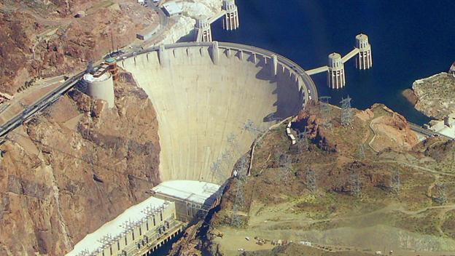
05-02 Pressure and Depth
Would Hoover Dam need to be just as strong if the entire lake behind the dam was reduced to an inch of water behind the dam, but the same depth as the lake?
Yes, the pressure
depends only on the depth
Notes:
Add a picture of Hoover Dam

Slide 22
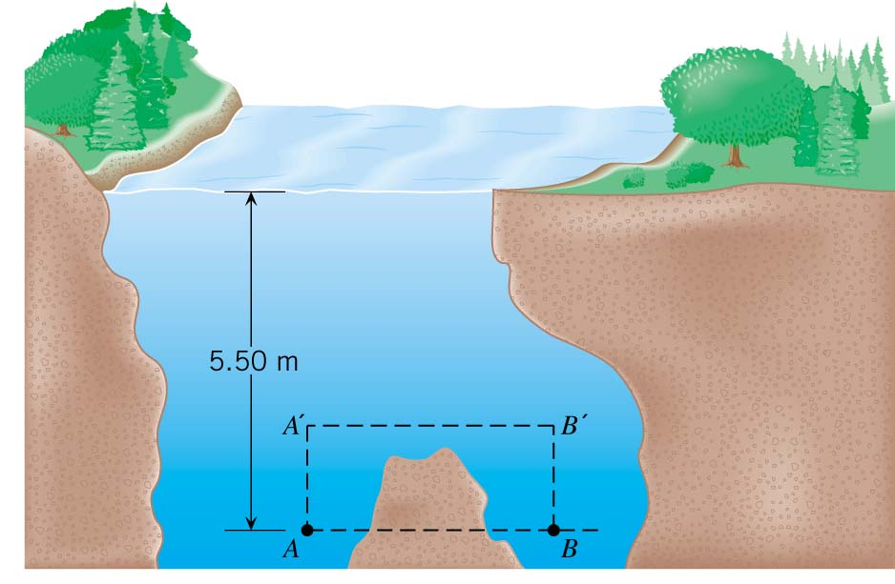
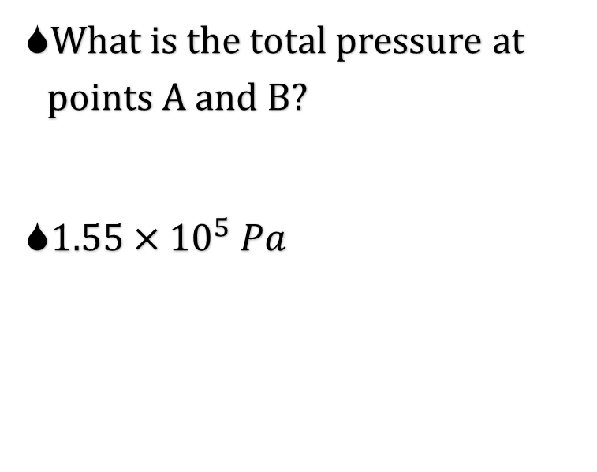
05-02 Pressure and Depth
What is the total pressure at points A and B?
$1.55×{10}^{5} Pa$
Notes:
$$P_{1}=1.013×{10}^{5} Pa$$
$$h=5.50 m$$
$$ρ=1000 kg/m^{3}$$
$$P_{A}=P_{1}+ρgh → 1.013×{10}^{5} Pa+\left(1000\frac{kg}{m^{3}}\right)\left(9.80\frac{m}{s^{2}}\right)\left(5.50 m\right)=1.55×{10}^{5} Pa$$
The pressures are the same because the depth is the same. It doesn’t matter that B has rock above it.

Slide 23
05-02 Homework
Yes, there is a lot of pressure riding on this assignment
Read 11.5, 11.6

Slide 24
05-03 Pascal’s Principle and Measuring Pressure
In this lesson you will…
• Define pressure.
• State Pascal’s principle.
• Understand applications of Pascal’s principle.
• Derive relationships between forces in a hydraulic system.
• Define gauge pressure and absolute pressure.

Slide 25
05-03 Pascal’s Principle and Measuring Pressure
Do the Pascal’s Principle Lab.
Did anything surprising happen?

Slide 26
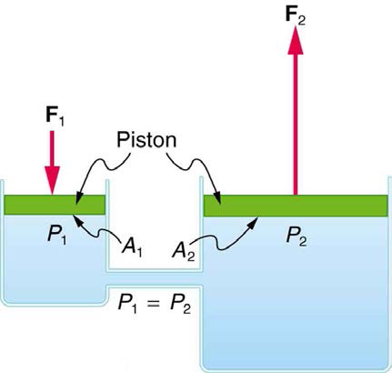
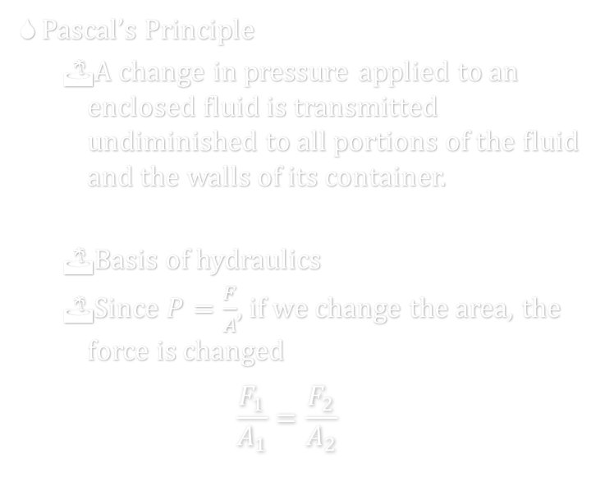
05-03 Pascal’s Principle and Measuring Pressure
Pascal’s Principle
  A change in pressure applied to an enclosed fluid is transmitted undiminished to all portions of the fluid and the walls of its container.
  Basis of hydraulics
  Since $P=\frac{F}{A}$, if we change the area, the force is changed
  $$\frac{F_{1}}{A_{1}}=\frac{F_{2}}{A_{2}}$$
Notes:
The fluid has no where to go. It flows in the container, but cannot go anywhere so the whole pressure increases.

Slide 27
05-03 Pascal’s Principle and Measuring Pressure
How much force must be exerted at A to support the 850-kg car at B? The piston at A has a diameter of 17 mm and the piston at B a diameter of 300 mm.
F = 26.7 N
B
A
Notes:
$$P=\frac{F}{A}$$
$$F_{car}=850 kg\left(9.8\frac{m}{s^{2}}\right)=8330 N$$
$$A_{car}=π{\left(0.150 m\right)}^{2}=0.0705858 m^{2}$$
$$F_{A}= ?$$
$$A_{A}=π{\left(0.0085m\right)}^{2}=0.00022698 m^{2}$$
$$\frac{F}{A}=\frac{F}{A}$$
$$\frac{8330 N}{0.0705858 m^{2}}=\frac{F}{0.00022698 m^{2}}$$
$$F=26.7 N$$

Slide 28
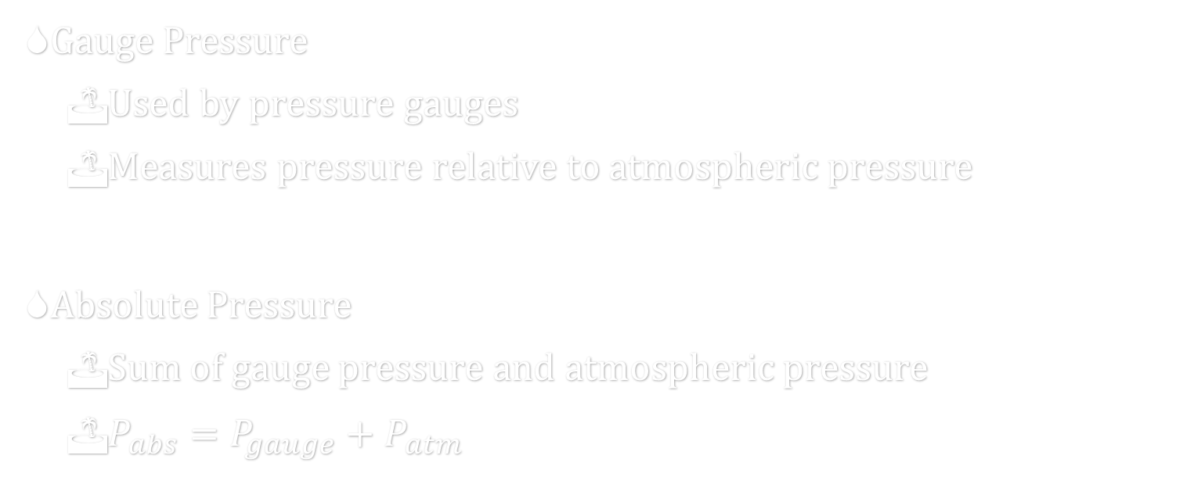
05-03 Pascal’s Principle and Measuring Pressure
Gauge Pressure
  Used by pressure gauges
  Measures pressure relative to atmospheric pressure
Absolute Pressure
  Sum of gauge pressure and atmospheric pressure
  $P_{abs}=P_{gauge}+P_{atm}$

Slide 29
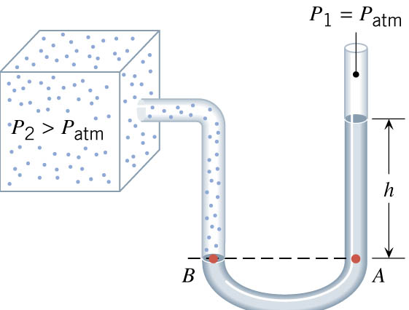

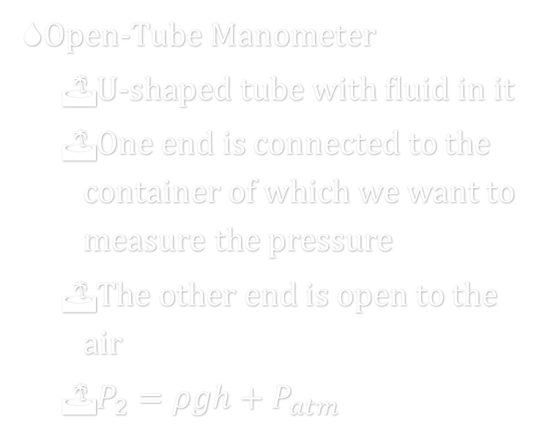
05-03 Pascal’s Principle and Measuring Pressure
Open-Tube Manometer
  U-shaped tube with fluid in it
  One end is connected to the container of which we want to measure the pressure
  The other end is open to the air
  $P_{2}=ρgh+P_{atm}$
$P_{2}=P_{abs}$
$P_{2}−P_{atm}=P_{gauge}$

Slide 30
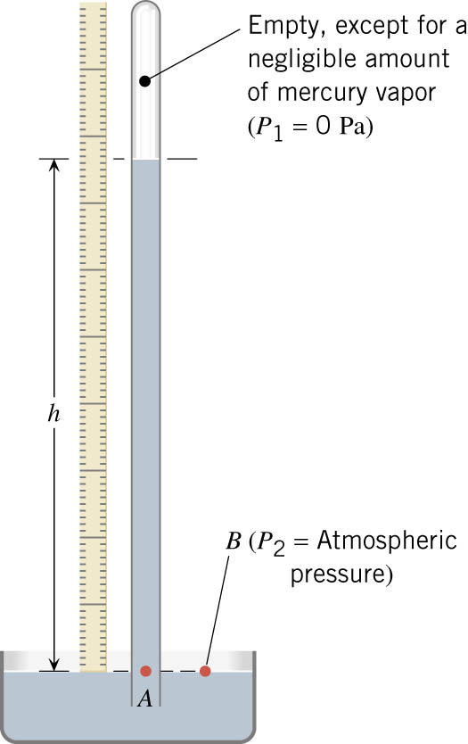
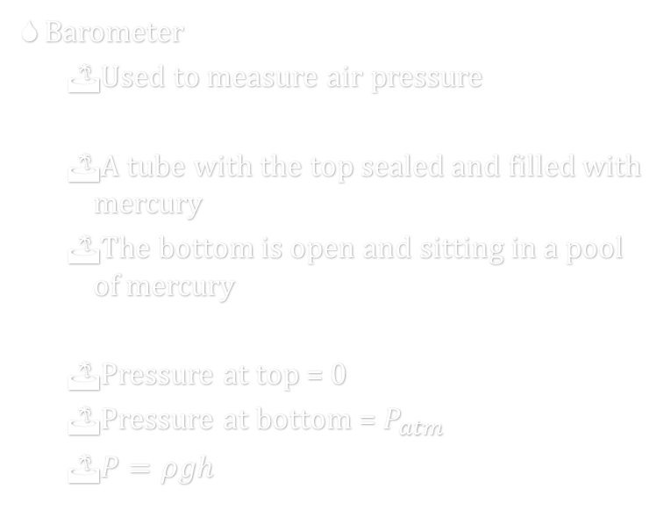
05-03 Pascal’s Principle and Measuring Pressure
Barometer
  Used to measure air pressure
  A tube with the top sealed and filled with mercury
  The bottom is open and sitting in a pool of mercury
  Pressure at top = 0
  Pressure at bottom = $P_{atm}$
  $P=ρgh$
Notes:
P₂ = ρgh
P₂ = 13600 kg/m³ (9.80m/s²)h
P₂ = 1.33x10⁵ Pa/m h
1 atm is 760 mm if we make P₂ = 1.013x10⁵ Pa
Changes in weather are often due to change in air pressure. Low pressure = bad weather; high pressure = sunny weather

Slide 31
05-03 Homework
Let me pressure you into solving these problems
Read 11.7

Slide 32
05-04 Archimedes’ Principle
In this lesson you will…
• Define buoyant force.
• State Archimedes’ principle.
• Understand why objects float or sink.
• Understand the relationship between density and Archimedes’ principle.

Slide 33
05-04 Archimedes’ Principle
Think of trying to push a beach ball under water
The water pushes it up
All fluids push things up because the pressure is higher at greater depths
The upward force is buoyant force

Slide 34
05-04 Archimedes’ Principle
Do the Buoyancy Lab.
When you are finished DRY the washer before putting them away!!
Make a conclusion about the buoyant force and the weight of water displaced.
Notes:
The buoyant force = weight of water displaced.

Slide 35
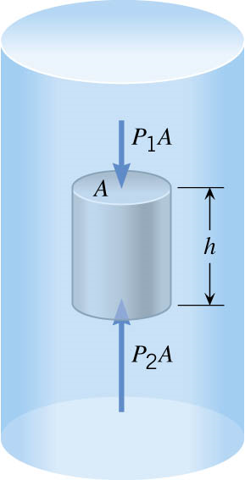


05-04 Archimedes’ Principle
$F_{B}=P_{2}A−P_{1}A$
$F_{B}=\left(P_{2}−P_{1}\right)A$
$P_{2}=P_{1}+ρgh → P_{2}−P_{1}=ρgh$
$F_{B}=\left(ρgh\right)A$
$ρ=\frac{m}{V} → m=ρV$
$V=Ah$
$m=ρhA$
$F_{B}=mg=W_{liquid}$

Slide 36
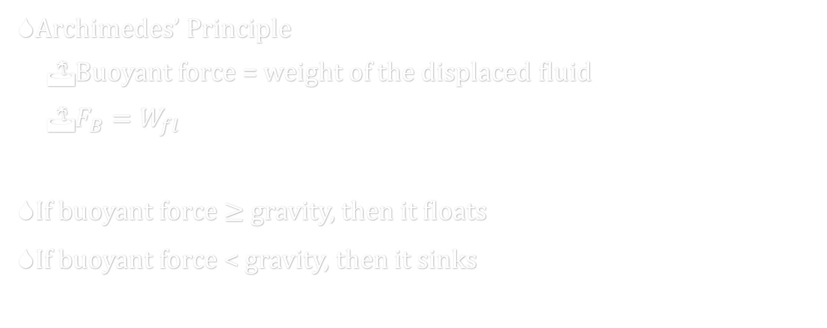
05-04 Archimedes’ Principle
Archimedes’ Principle
  Buoyant force = weight of the displaced fluid
  $F_{B}=W_{fl}$
If buoyant force $≥$ gravity, then it floats
If buoyant force < gravity, then it sinks

Slide 37
05-04 Archimedes’ Principle
As you might have guessed
  An object will float if its average density < density of the fluid
  In other words, it will float if it displaces more fluid than its own weight
Notes:
For not solid objects, think of a boat

Slide 38

05-04 Archimedes’ Principle
Specific Gravity
  $specific gravity=\frac{\overline{ρ}}{ρ_{fl}}=fraction submerged$
  If specific gravity < 1 it floats
  If specific gravity > 1 it sinks

Slide 39
05-04 Archimedes’ Principle
An ice cube is floating in a glass of fresh water. The cube is 3 cm on each side. If the cube is floating so a flat face is facing up, what is the distance between the top of the cube and the water?
0.25 cm
h
Notes:
$$\frac{\overline{ρ}}{ρ_{fl}}=fraction submerged$$
$$\frac{917\frac{kg}{m^{3}}}{1000\frac{kg}{m^{3}}}=0.917$$
$$0.917\left(3 cm\right)=2.751 cm submerged$$
$$3 cm−2.751 cm=0.249 cm above$$

Slide 40
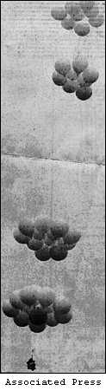
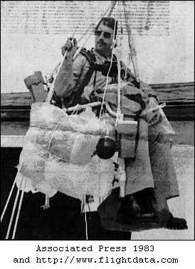
05-04 Archimedes’ Principle
A man tied a bunch of helium balloons to a lawn chair and flew to a great altitude. If a single balloon is estimated as a sphere with a radius of 20 cm and is filled with helium, what is the net force on one balloon?
  0.3648 N
How many balloons would be required
to lift a 80 kg man and chair?
  2150 balloons
Notes:
$$∑F=F_{B}−W_{He}$$
$$V_{balloon}=\frac{4}{3}π{\left(0.2 m\right)}^{3}=0.03351 m^{3}$$
$$F_{B}=ρ_{air}V_{balloon}g=\left(1.29\frac{kg}{m^{3}}\right)\left(0.03351 m^{3}\right)\left(9.8\frac{m}{s^{2}}\right)=0.4236 N$$
$$W_{He}=ρ_{He}V_{balloon}g=\left(0.179\frac{kg}{m^{3}}\right)\left(0.03351 m^{3}\right)\left(9.8\frac{m}{s^{2}}\right)=0.05878 N$$
$$∑F=0.4236 N−0.05878 N=0.3648 N$$
$$∑F=F_{B}x−W_{He}x−W_{man}=0$$
$$\left(0.3648 N\right)x−\left(80 kg\right)\left(9.8\frac{m}{s^{2}}\right)=0$$
$$\left(0.3648 N\right)x=784 N$$
$$x=2150 balloons$$

Slide 41
05-04 Homework
Be buoyed up by the thought of the joy derived from solving these problems
Read 12.1, 12.2

Slide 42
05-05 Flow Rate and Bernoulli’s Equation
In this lesson you will…
• Calculate flow rate.
• Describe incompressible fluids.
• Explain the consequences of the equation of continuity.
• Explain the terms in Bernoulli’s equation.
• Explain how Bernoulli’s equation is related to conservation of energy.
• Calculate with Bernoulli’s principle.
• List some applications of Bernoulli’s principle.

Slide 43
05-05 Flow Rate and Bernoulli’s Equation
Do the Air Streams Lab
All the motion observed in this lab was caused by differences in pressure.
In all the experiments, which way is the object move: towards or away from the moving air?
An object will move from higher to lower pressure. Where was the pressure the lowest: moving or still air?
Where was the pressure the highest?
Notes:
Towards
Moving air
Still air

Slide 44
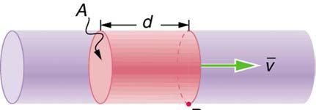


05-05 Flow Rate and Bernoulli’s Equation
Flow Rate
  $Q=\frac{V}{t}$
    Q = Flow rate
    V = Volume of fluid
    t = time
  $Q=\frac{V}{t}=\frac{Ad}{t}=A\overline{v}$
  A = cross-section area
  $\overline{v}$ = average velocity of fluid

Slide 45
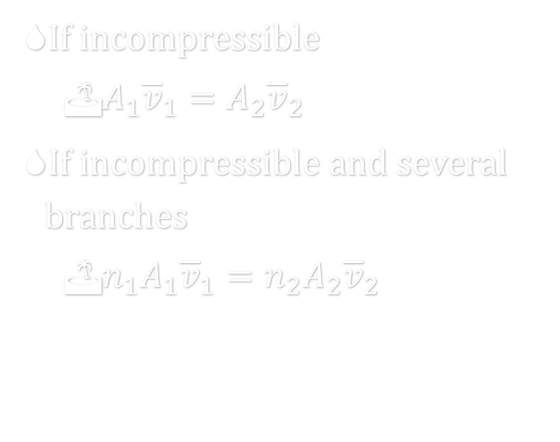
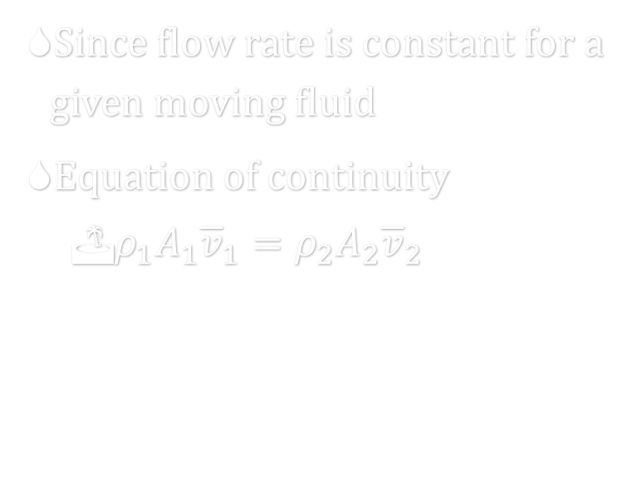
05-05 Flow Rate and Bernoulli’s Equation
Since flow rate is constant for a given moving fluid
Equation of continuity
  $ρ_{1}A_{1}{\overline{v}}_{1}=ρ_{2}A_{2}{\overline{v}}_{2}$
If incompressible
  $A_{1}{\overline{v}}_{1}=A_{2}{\overline{v}}_{2}$
If incompressible and several branches
  $n_{1}A_{1}{\overline{v}}_{1}=n_{2}A_{2}{\overline{v}}_{2}$

Slide 46
05-05 Flow Rate and Bernoulli’s Equation
Where does the water flow the fastest?
A
B
C
Notes:
B, then C, then A
My old woodstove had 8in round pipe, then entered 10in square chimney. Since the area got bigger, the smoke slowed down. That let the creosote in the smoke build up on the chimney walls more and cause chimney fires.

Slide 47
05-05 Flow Rate and Bernoulli’s Equation
A garden hose has a diameter of 2 cm and water enters it at 0.5 m/s. You block 90% of the end of the hose with your thumb. How fast does the water exit the hose?
v = 5 m/s
Notes:
Incompressible so
$$A_{1}{\overline{v}}_{1}=A_{2}{\overline{v}}_{2}$$
$$\left(π{\left(0.01 m\right)}^{2}\right)\left(0.5\frac{m}{s}\right)=0.1\left(π{\left(0.01 m\right)}^{2}\right)v$$
$$v=5\frac{m}{s}$$

Slide 48
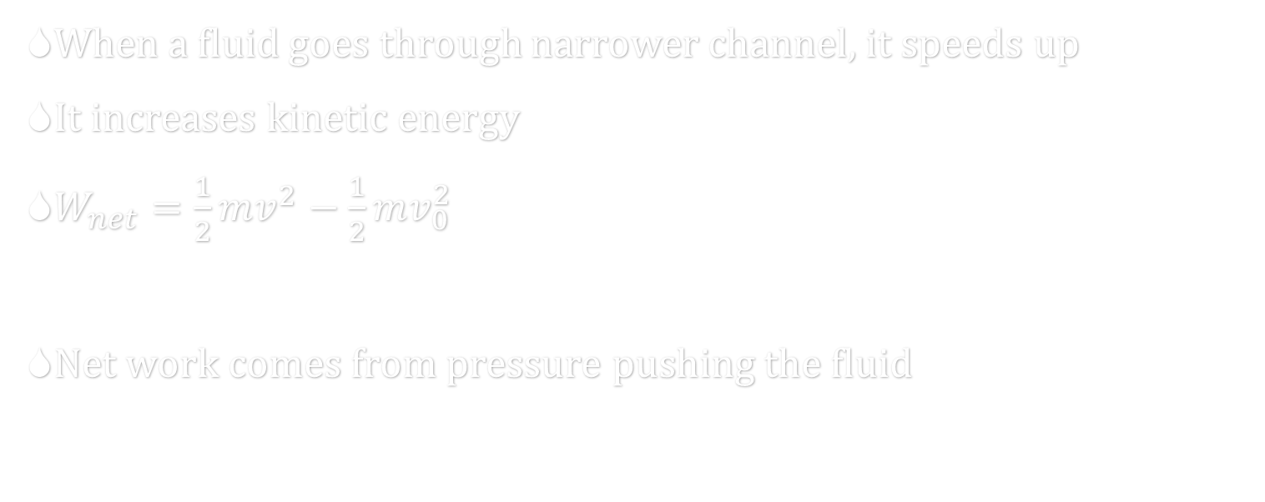
05-05 Flow Rate and Bernoulli’s Equation
When a fluid goes through narrower channel, it speeds up
It increases kinetic energy
$W_{net}=\frac{1}{2}mv^{2}−\frac{1}{2}mv_{0}^{2}$
Net work comes from pressure pushing the fluid

Slide 49
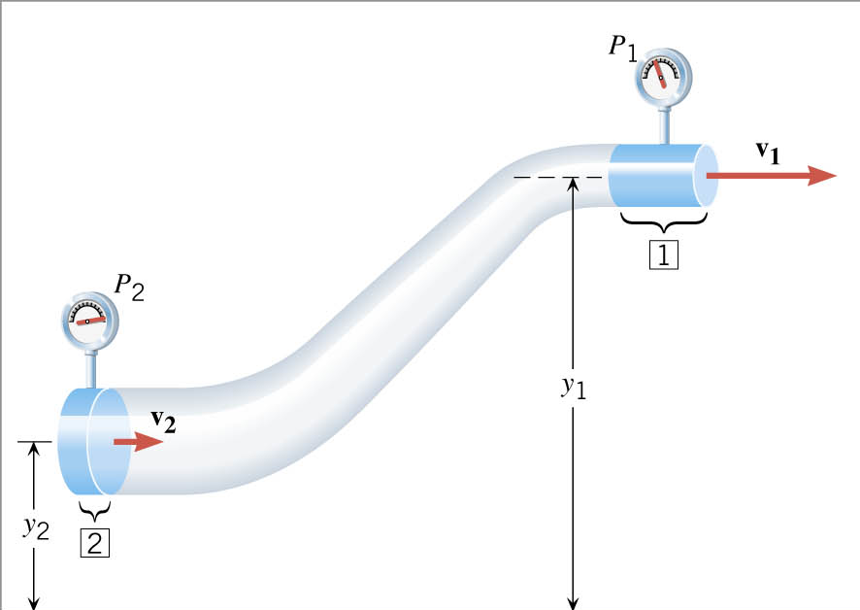
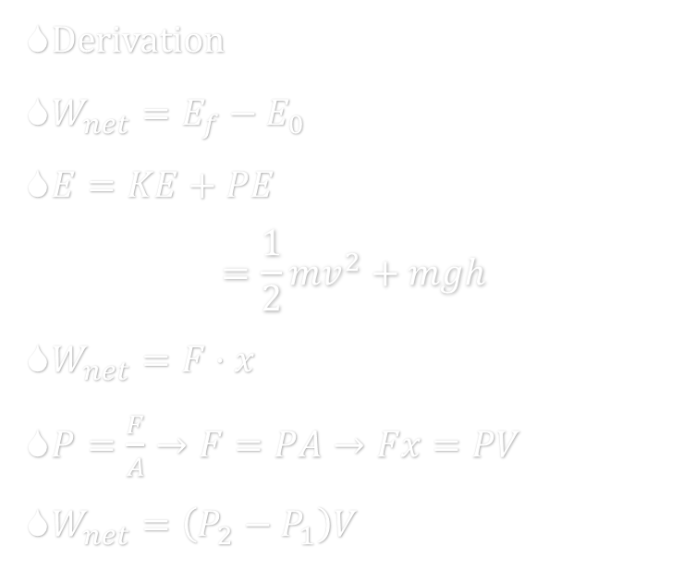
05-05 Flow Rate and Bernoulli’s Equation
Derivation
$W_{net}=E_{f}−E_{0}$
$E=KE+PE$
$=\frac{1}{2}{mv}^{2}+mgh$
$W_{net}=F⋅x$
$P=\frac{F}{A}→F=PA→Fx=PV$
$W_{net}=\left(P_{2}−P_{1}\right)V$

Slide 50
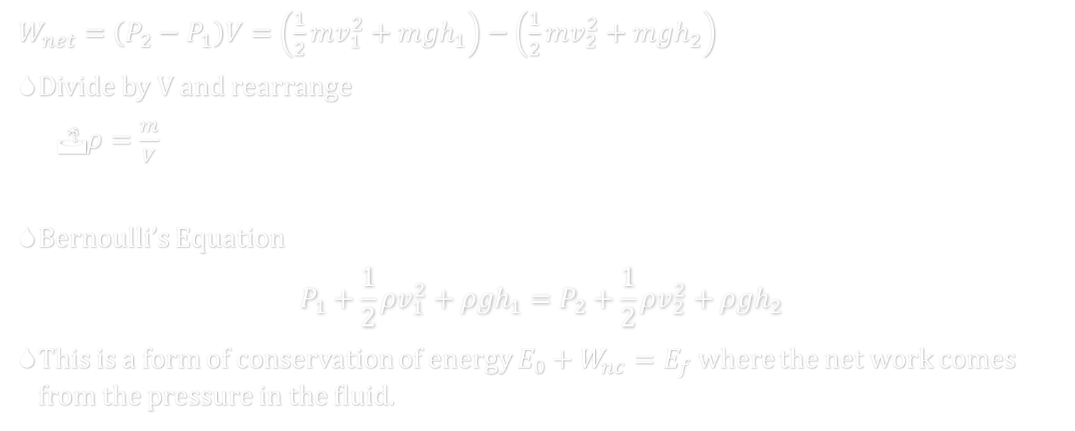
05-05 Flow Rate and Bernoulli’s Equation
$W_{net}=\left(P_{2}−P_{1}\right)V=\left(\frac{1}{2}mv_{1}^{2}+mgh_{1}\right)−\left(\frac{1}{2}mv_{2}^{2}+mgh_{2}\right)$
Divide by V and rearrange
  $ρ=\frac{m}{V}$
Bernoulli’s Equation
$$P_{1}+\frac{1}{2}ρv_{1}^{2}+ρgh_{1}=P_{2}+\frac{1}{2}ρv_{2}^{2}+ρgh_{2}$$
This is a form of conservation of energy $E_{0}+W_{nc}=E_{f}$ where the net work comes from the pressure in the fluid.

Slide 51
05-05 Flow Rate and Bernoulli’s Equation
Think about driving down a road with something in your car’s trunk. The object is too large to completely shut the trunk lid. While the car is stopped, the lid quietly rests as far down as it can go. As you drive down the road, why does the trunk open?
The air in the trunk is still. The air above the trunk is moving.
The air in the trunk is at a higher pressure than above the trunk. So the trunk is pushed open.

Slide 52
05-05 Flow Rate and Bernoulli’s Equation
The blood speed in a normal segment of a horizontal artery is 0.15 m/s. An abnormal segment of the artery is narrowed down by an arteriosclerotic plaque to one-half the normal cross-sectional area. What is the difference in blood pressures between the normal and constricted segments of the artery?
35.8 Pa
Notes:
$$P_{1}+\frac{1}{2}ρv_{1}^{2}+ρgh_{1}=P_{2}+\frac{1}{2}ρv_{2}^{2}+ρgh_{2}$$
$$P_{1}−P_{2}=\frac{1}{2}ρv_{2}^{2}−\frac{1}{2}ρv_{1}^{2}$$
$$A_{1}v_{1}=A_{2}v_{2}$$
$$A_{1}0.15\frac{m}{s}=\frac{1}{2}A_{1}v_{2}→v_{2}=0.30\frac{m}{s}$$
$$P_{1}−P_{2}=\frac{1}{2}\left(1060\frac{kg}{m^{3}}\right){\left(0.30\frac{m}{s}\right)}^{2}−\frac{1}{2}\left(1060\frac{kg}{m^{3}}\right){\left(0.15\frac{m}{s}\right)}^{2}$$
$$P_{1}−P_{2}=35.8 Pa$$

Slide 53
05-05 Flow Rate and Bernoulli’s Equation
Why do all houses need a plumbing vent?
Waste water flows through a sewer line.
Something like a sink is connected to the line, but there is a water trap to keep the sewer gasses from entering the house.
The flowing water in the sewer means the air directly above the flowing water has a lower pressure than the air above the sink.
This pushes the water in the trap down the pipe and sewer gasses enter the house

Slide 54
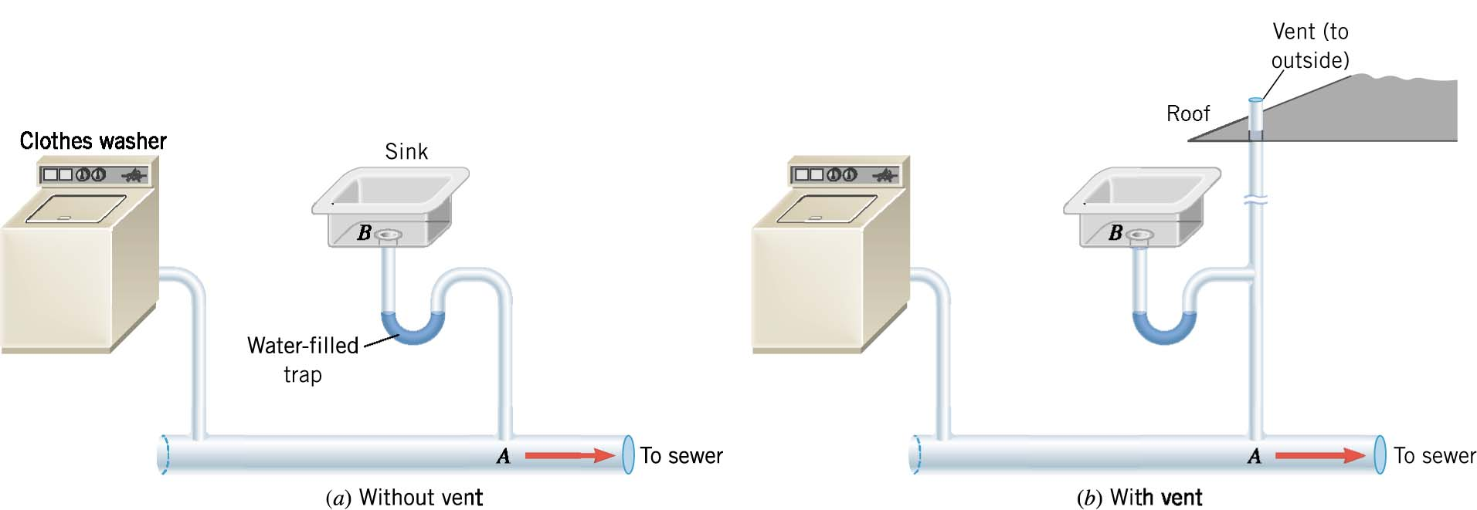
05-05 Flow Rate and Bernoulli’s Equation

Slide 55
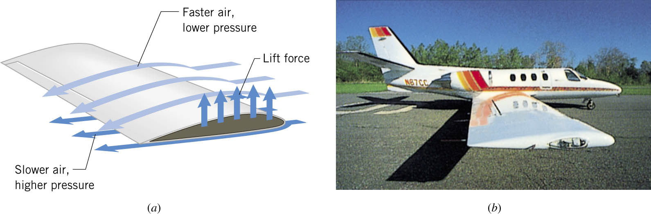
05-05 Flow Rate and Bernoulli’s Equation
How do airplane wings work (even paper airplanes)?
The top of the wing is curved and the bottom is not. The air flows faster over the top of the wing, than the bottom. This pushes the wing up.

Slide 56
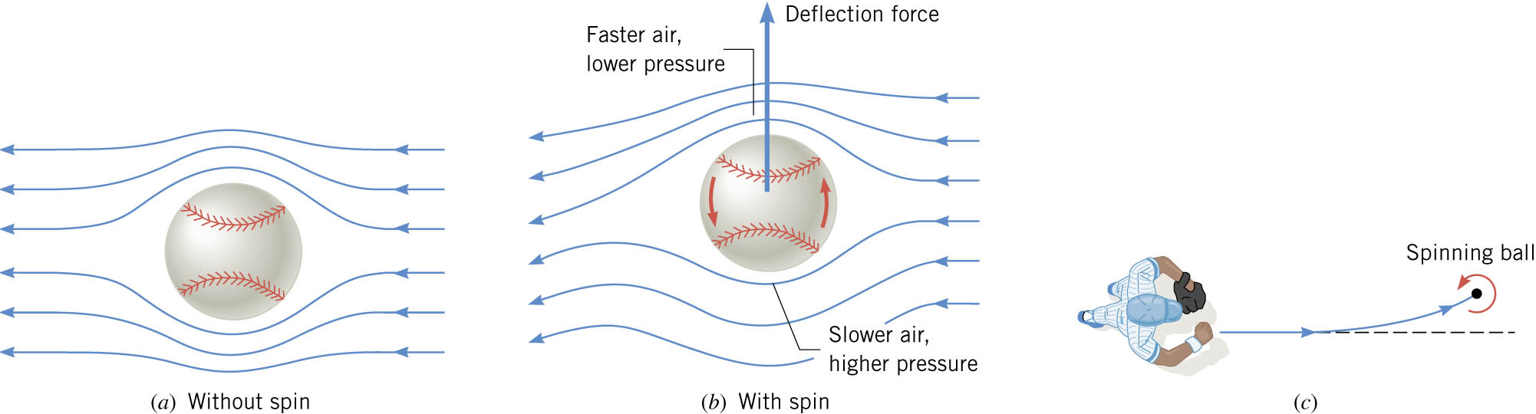
05-05 Flow Rate and Bernoulli’s Equation
How does a curve ball in baseball work?
Notes:
Bottom: spin against air flow → slow relative velocity → high pressure
Top: spin with air flow → fast relative velocity → low pressure

Slide 57
05-05 Homework
The faster you work, the less pressure you’ll feel?
Read 12.3

Slide 58
05-06 The Most General Applications of Bernoulli’s Equation
In this lesson you will…
• Calculate with Bernoulli’s principle.
• Calculate power in fluid flow.

Slide 59
05-06 The Most General Applications of Bernoulli’s Equation
Previous examples of Bernoulli’s Equation had simplified conditions
Bernoulli’s Equation work in real world

Slide 60
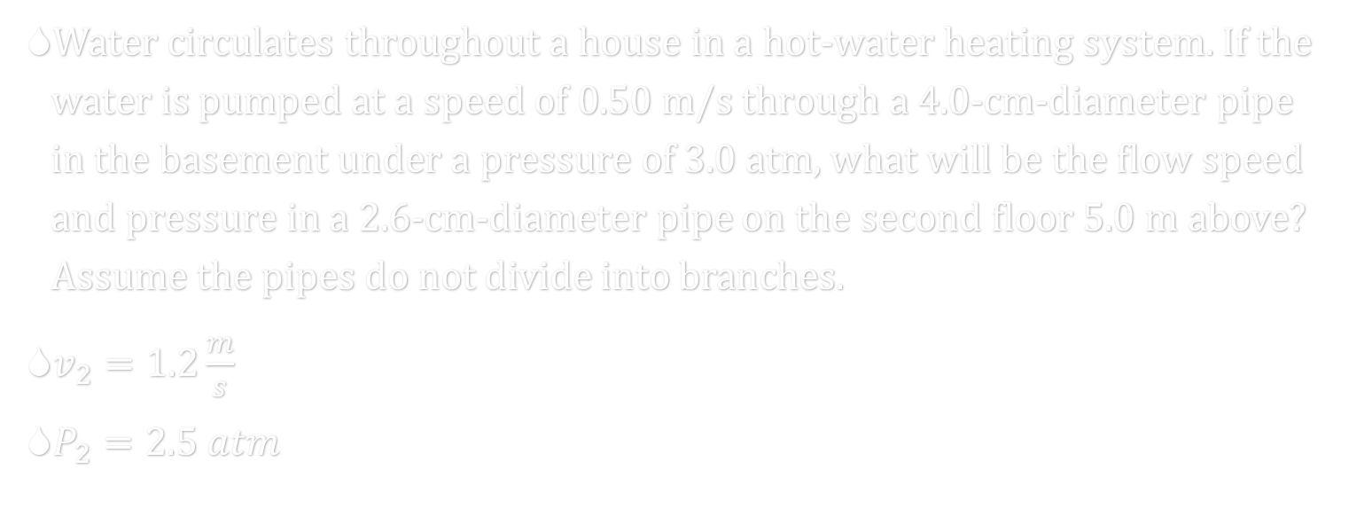
05-06 The Most General Applications of Bernoulli’s Equation
Water circulates throughout a house in a hot-water heating system. If the water is pumped at a speed of 0.50 m/s through a 4.0-cm-diameter pipe in the basement under a pressure of 3.0 atm, what will be the flow speed and pressure in a 2.6-cm-diameter pipe on the second floor 5.0 m above? Assume the pipes do not divide into branches.
$v_{2}=1.2\frac{m}{s}$
$P_{2}=2.5 atm$
Notes:
Equation of Continuity
$$v_{1}A_{1}=v_{2}A_{2}$$
$$\left(0.50\frac{m}{s}\right)\left(π{\left(0.02 m\right)}^{2}\right)=v_{2}\left(π{\left(0.013 m\right)}^{2}\right)$$
$$v_{2}=1.183\frac{m}{s}$$
Bernoulli’s Equation
$$P_{1}+\frac{1}{2}ρv_{1}^{2}+ρgh_{1}=P_{2}+\frac{1}{2}ρv_{2}^{2}+ρgh_{2}$$
$$\left(3\left(1.01×{10}^{5} Pa\right)\right)+\frac{1}{2}\left(1000\frac{kg}{m^{3}}\right){\left(0.50\frac{m}{s}\right)}^{2}+0=P_{2}+\frac{1}{2}\left(1000\frac{kg}{m^{3}}\right){\left(1.183\frac{m}{s}\right)}^{2}+\left(1000\frac{kg}{m^{3}}\right)\left(9.8\frac{m}{s^{2}}\right)\left(5.0 m\right)$$
$$303125 Pa=P_{2}+49700 Pa$$
$$P_{2}=253425 Pa=2.5 atm$$

Slide 61
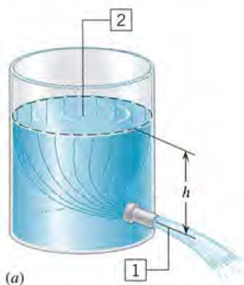
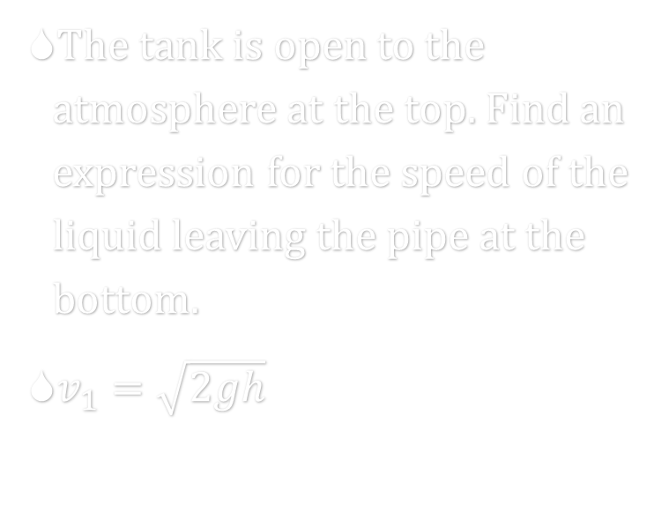
05-06 The Most General Applications of Bernoulli’s Equation
The tank is open to the atmosphere at the top. Find an expression for the speed of the liquid leaving the pipe at the bottom.
$v_{1}=\sqrt{2gh}$
Notes:
$$P_{1}+\frac{1}{2}ρv_{1}^{2}+ρgh_{1}=P_{2}+\frac{1}{2}ρv_{2}^{2}+ρgh_{2}$$
$$1 atm+\frac{1}{2}ρv_{1}^{2}+0=1 atm+0+ρgh$$
$$\frac{1}{2}ρv_{1}^{2}=ρgh$$
$$\frac{1}{2}v_{1}^{2}=gh$$
$$v_{1}=\sqrt{2gh}$$

Slide 62
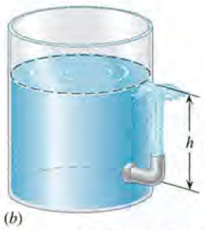
05-06 The Most General Applications of Bernoulli’s Equation
Since Bernoulli’s Equation is conservation of energy, the water would rise up to the same height as the water in the tank.

Slide 63
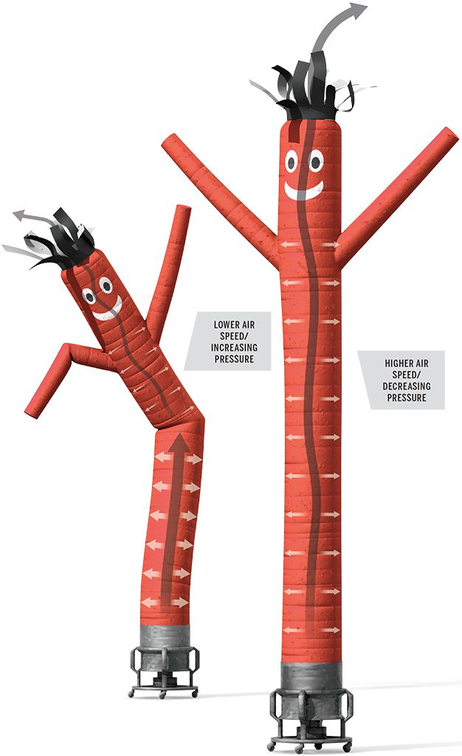
05-06 The Most General Applications of Bernoulli’s Equation
AirDancer used to draw attention at used car lots.
The behavior is explained by Bernoulli’s principle.
Initially, the moving air, which behaves as an incompressible flow in the open-ended AirDancer, creates enough pressure to inflate the tube.
As the tube stands more upright, the turbulent air inside flows more freely and its speed increases until the decreasing pressure can no longer support the mass of the nylon fabric.
The collapsing material creates a kink in the tube, a constriction that causes the air speed to temporarily slow and the pressure to rise again.
The elevated pressure drives the bend upward, sending a shimmy through the AirDancer and restarting the cycle.

Slide 64
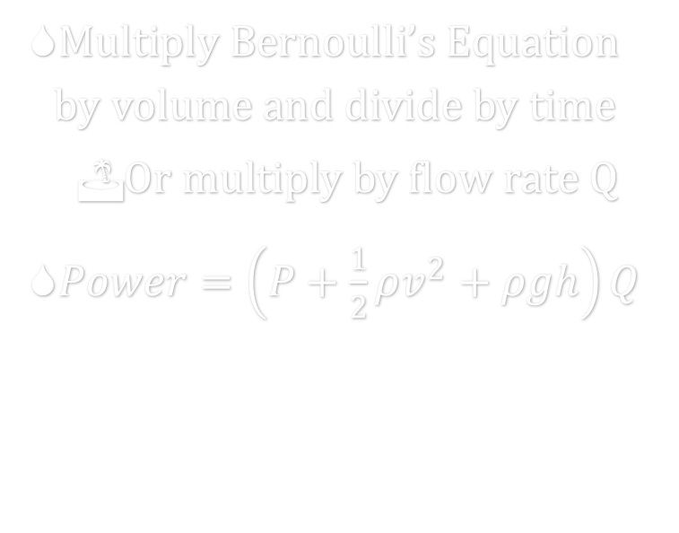
05-06 The Most General Applications of Bernoulli’s Equation
Power in Fluid Flow
Power is rate of work or energy
Bernoulli’s Equation terms are in energy per volume
$\text{Multiply} \text{Bernoulli}\text{’}\text{s} \text{Equation} \text{by} \text{volume} \text{and} \text{divide} \text{by} \text{time}$
  $\text{Or} \text{multiply} \text{by} \text{flow} \text{rate} \text{Q}$
$Power=\left(P+\frac{1}{2}ρv^{2}+ρgh\right)Q$

Slide 65
05-06 Homework
Apply yourself to these applications
Read 12.4, 12.5

Slide 66
05-07 Viscosity, Poiseuille’s Law, and Turbulence
In this lesson you will…
• Define laminar flow and turbulent flow.
• Explain what viscosity is.
• Calculate flow and resistance with Poiseuille’s law.
• Explain how pressure drops due to resistance.
• Calculate Reynolds number.
• Use the Reynolds number for a system to determine whether it is laminar or turbulent.

Slide 67
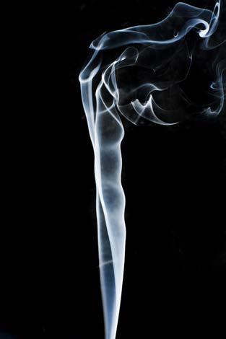
05-07 Viscosity, Poiseuille’s Law, and Turbulence
Viscosity
  Fluid friction
Laminar Flow
  Smooth flow in layers that don’t mix
Turbulent Flow
  Has eddies and swirls that mix layers of fluid
  Turbulent flow is slower than laminar flow
Turbulent
Laminar

Slide 68
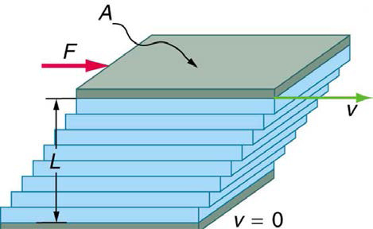
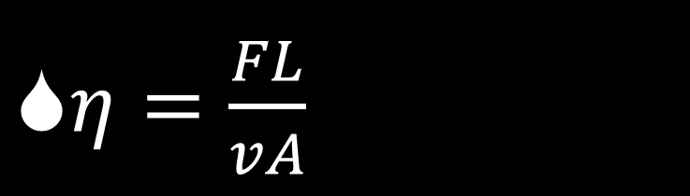
05-07 Viscosity, Poiseuille’s Law, and Turbulence
How viscosity is measured
  Two plates with fluid between
  Top plate moved
  Friction causes the fluid to move
$η=\frac{FL}{vA}$
Notes:
$η$ is coefficient of viscosity
F is force applied to top plate
L is distance between plates
v is speed that top plate is moved
A is area of plate

Slide 69
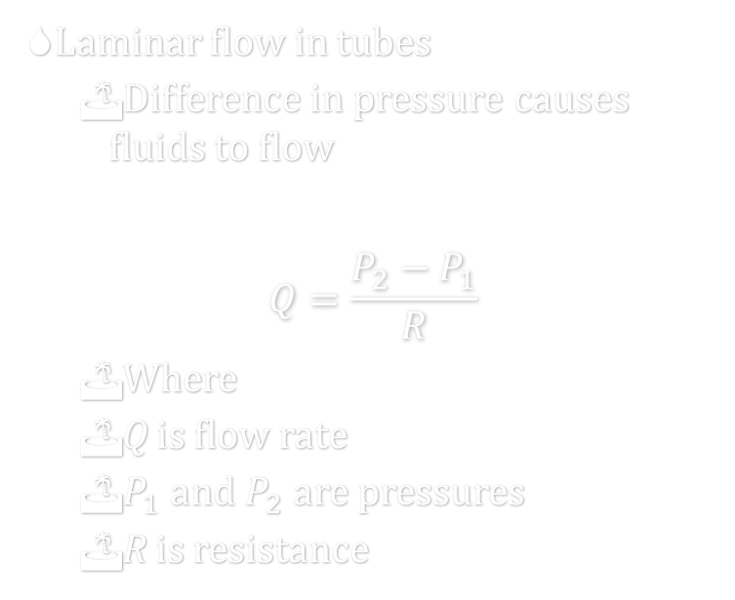

05-07 Viscosity, Poiseuille’s Law, and Turbulence
Laminar flow in tubes
  Difference in pressure causes fluids to flow
$$Q=\frac{P_{2}−P_{1}}{R}$$
  Where
  Q is flow rate
  $P_{1}$ and $P_{2}$ are pressures
  R is resistance
Poiseuille’s law for resistance
$$R=\frac{8ηl}{πr^{4}}$$
  Where
  $η$ is viscosity
  l is length of tube
  r is radius of tube
Notes:
Resistance is most effected by radius

Slide 70
05-07 Viscosity, Poiseuille’s Law, and Turbulence
Since flow rate depends on pressure
  Higher pressure difference, higher Q
  Higher resistance, higher pressure difference to maintain constant Q
    In blood vessels this is a problem with plaque on artery walls

Slide 71

05-07 Viscosity, Poiseuille’s Law, and Turbulence
How to tell if laminar or turbulent flow
  Low speed with smooth, streamlined object → laminar
  High speed or rough object → turbulent
Reynolds number
  Below 2000 → laminar
  Above 3000 → turbulent
  Between 2000 and 3000 depends on conditions
$$N_{R}=\frac{2ρvr}{η}$$
Notes:
$$N_{R}=Reynolds number$$
$$ρ=fluid density$$
$$v=speed of fluid$$
$$r=radius of tube$$
$$η=viscosity$$

Slide 72



05-07 Viscosity, Poiseuille’s Law, and Turbulence
A hypodermic syringe is filled with a solution whose viscosity is $1.5×{10}^{−3} Pa⋅s$. The plunger area of the syringe is $8.0×{10}^{−5} m^{2}$, and the length of the needle is 0.025 m. The internal radius of the needle is $4.0×{10}^{−4} m$. The gauge pressure in a vein is 1900 Pa (14 mmHg). What force must be applied to the plunger, so that $1.0×{10}^{−6} m^{3}$ of solution can be injected in 3.0 s?
$F=0.25$ N
Is the flow laminar if the density is 1000 kg/m³?
$N_{R}=353$; Yes
Notes:
$$η=1.5×{10}^{−3} Pa⋅s, l=0.025 m, r=4.0×{10}^{−4} m, P_{1}=1900 Pa, V=1.0×{10}^{−6} m^{3}, t=3.0 s$$
$$Q=\frac{V}{t}=\frac{1.0×{10}^{−6} m^{3}}{3.0 s}=3.3×{10}^{−7} m^{3}/s$$
$$R=\frac{8ηl}{πr^{4}}=\frac{8\left(1.5×{10}^{−3} Pa⋅s\right)\left(0.025 m\right)}{π{\left(4.0×{10}^{−4} m\right)}^{4}}=3.730×{10}^{9} Pa⋅s/m^{3}$$
$$Q=\frac{P_{2}−P_{1}}{R}$$
$$3.3×{10}^{−7}\frac{m^{3}}{s}=\frac{P_{2}−1900 Pa}{3.730×{10}^{9}\frac{Pa⋅s}{m^{3}}}$$
$$P_{2}−1900 Pa=1243 Pa$$
$$P_{2}=3143 Pa$$
$$P=\frac{F}{A}$$
$$3143 Pa=\frac{F}{8.0×{10}^{−5} m^{2}}$$
$$F=0.25 N$$
Laminar?
$$Q=Av→3.33×{10}^{−7}\frac{m^{3}}{s}=π{\left(4×{10}^{−4} m\right)}^{2}v→v=0.662 m/s$$
$$N_{R}=\frac{2ρvr}{η}=\frac{2\left(1000\frac{kg}{m^{3}}\right)\left(0.662\frac{m}{s}\right)\left(4.0×{10}^{−4} m\right)}{1.5×{10}^{−3} Pa⋅s}=353$$

Slide 73
05-07 Homework
Let the answers flow

